Slide 1
Crop Recommendation Using Weather and Soil Content
By: Dev Chakraborty

Slide 2
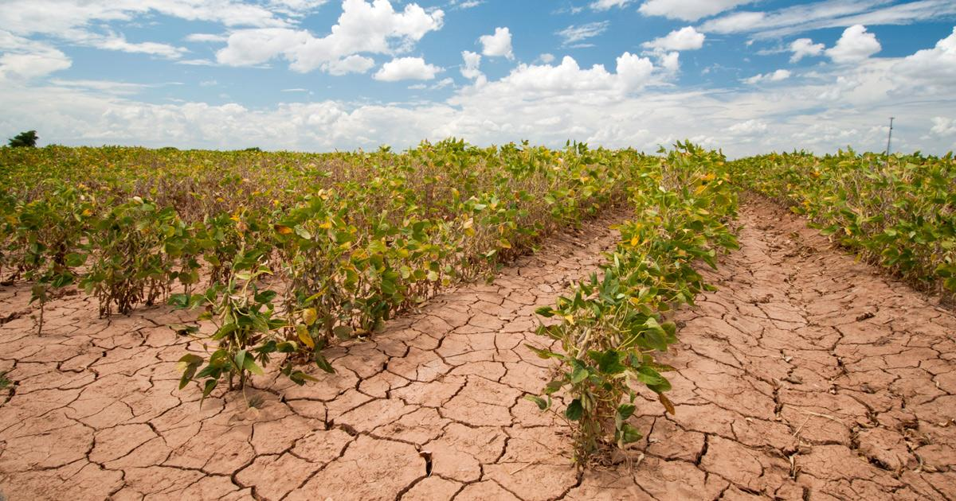
Due to Climate change weather pattern is changing and making farming more risky

Slide 3
Better Crop Choice
Trying to recommend from the data findings a crop for the cultivation based on soil conditions and weather conditions. To yield maximum amount.

Slide 4
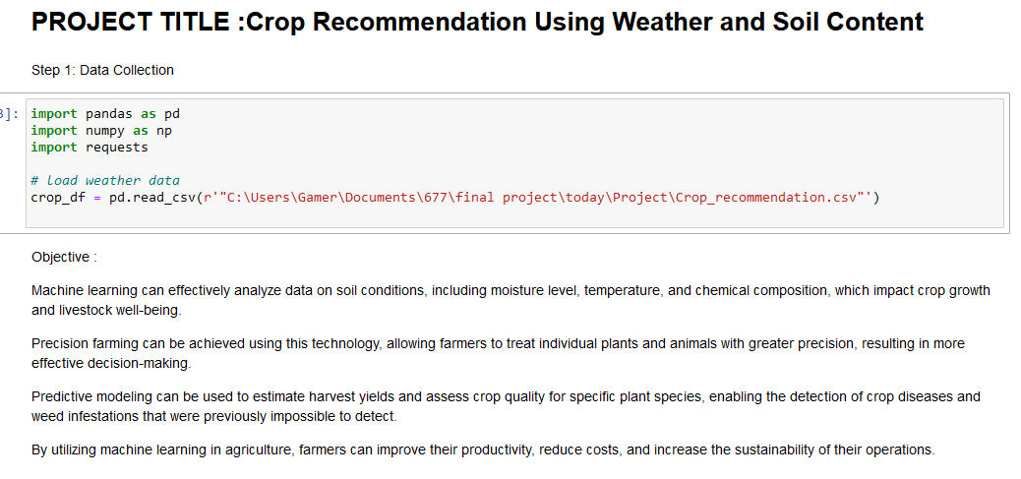

Slide 5
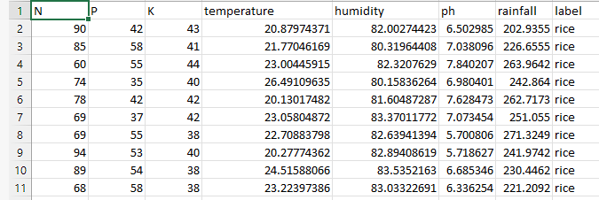
The data set used:

Slide 6
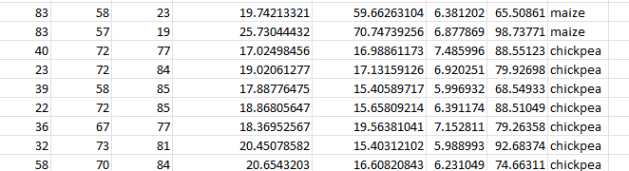
The data set used:

Slide 7
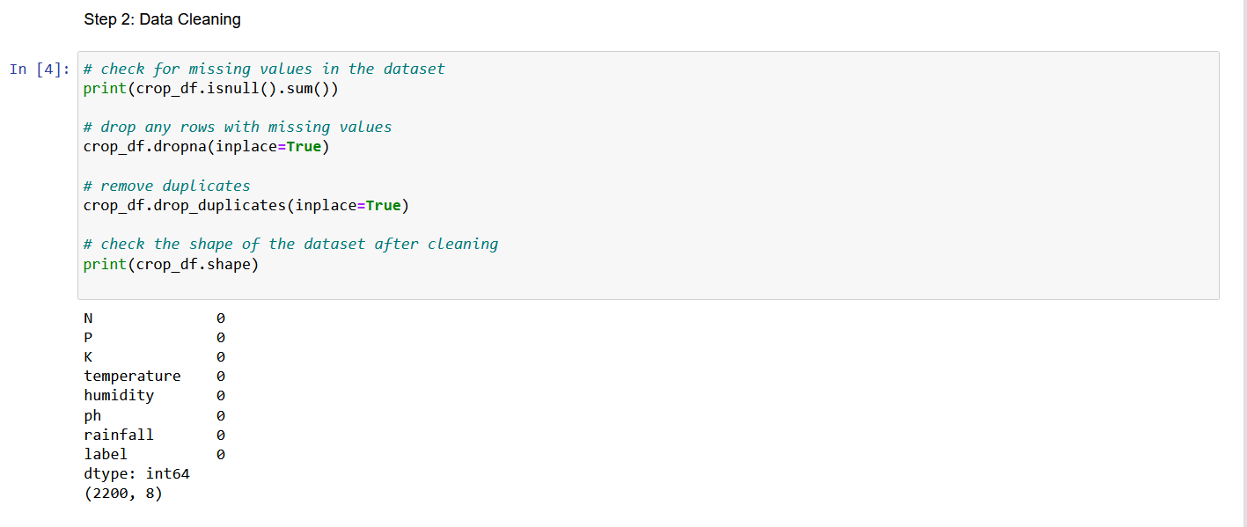

Slide 8
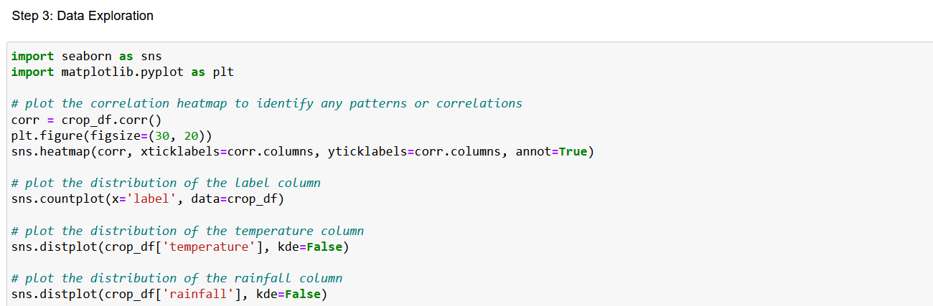
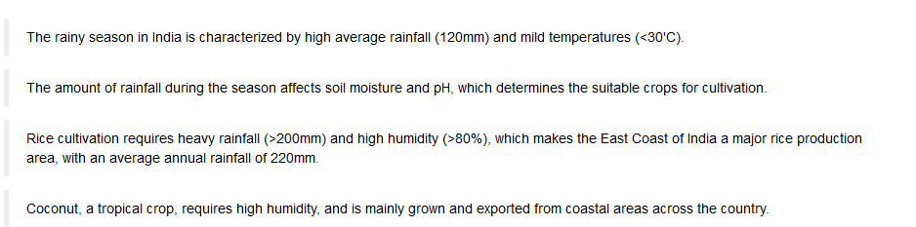

Slide 9
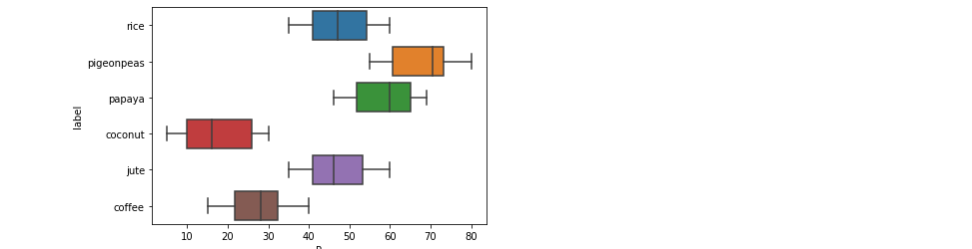

Slide 10
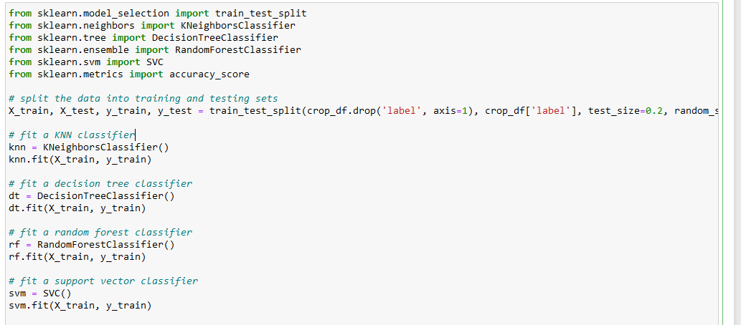
Step 4: Model Development

Slide 11
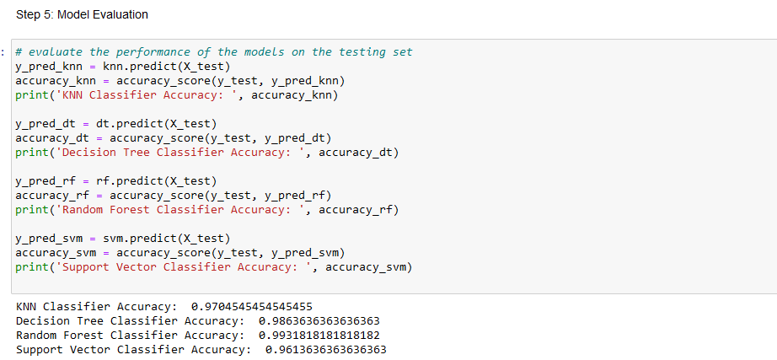

Slide 12
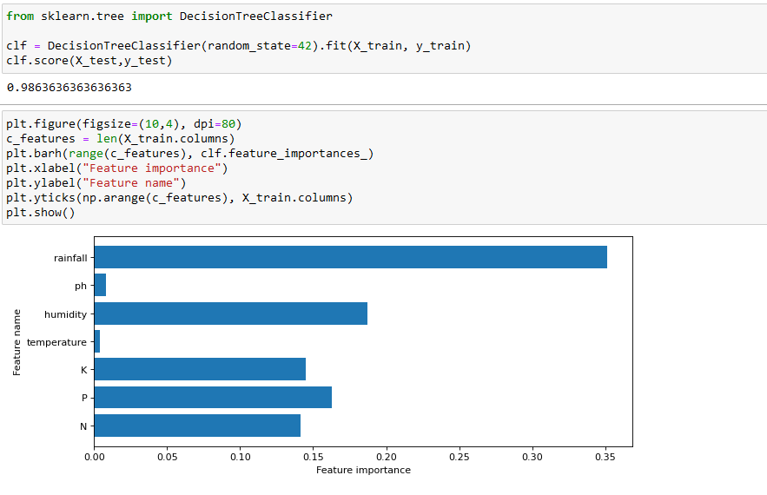

Slide 13
If I had more time for the project . Farmer need Results in Real Time
Difficulty faced was in farming weather and soil condition are ever changing.
Making it hard to detect quality of various plant species crops to detect crop diseases and weed infestations.

Slide 14
Real Time Data Collection
With the help of sensor systems would be able to obtain and run Real-time processing.
This will give farmers valuable information real time so they can protect their crops and achieve higher yield in the process.

Slide 15
Source:
https://www.kaggle.com
Crop Recommendation Data Set
Thank You

